Slide 1

SQL PROJECT

Slide 2


Online Shopping System

Slide 3
INTRODUCTION
Creating an SQL project for an online shopping website is an excellent way to apply database management skills and simulate real-world e-commerce scenarios. In this project, SQL (Structured Query Language) is used to manage and manipulate the data for various components of the website, such as products, customers, orders, and payments.
By building a project around an online shopping website, you gain valuable experience in designing and querying relational databases. SQL is essential for efficiently managing data, handling complex queries, and performing operations like creating reports or managing customer and product data. It is a foundational skill for database administrators, backend developers, and data analysts working in the e-commerce domain.

Slide 4
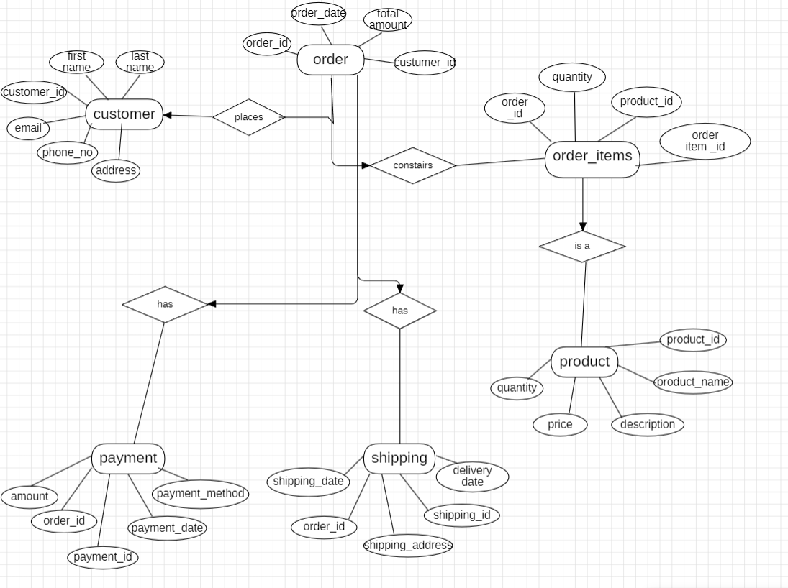
ER-diagram

Slide 5
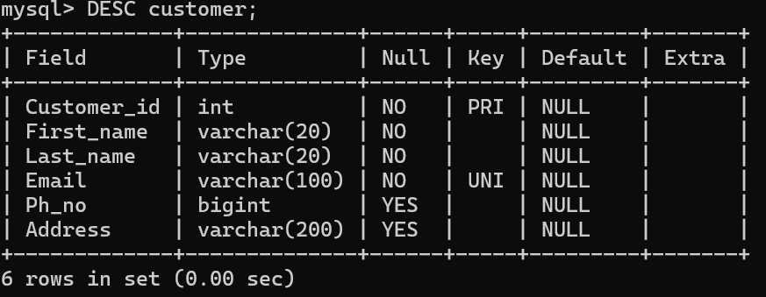
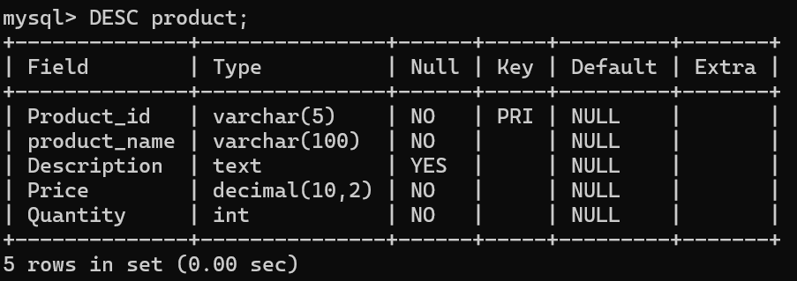
STRUCTURE OF TABLES
CUSTOMER TABLE:
PRODUCT TABLE:

Slide 6
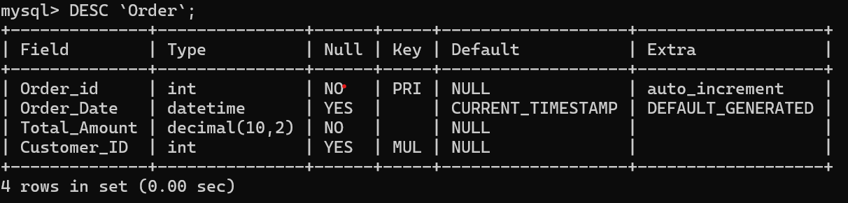
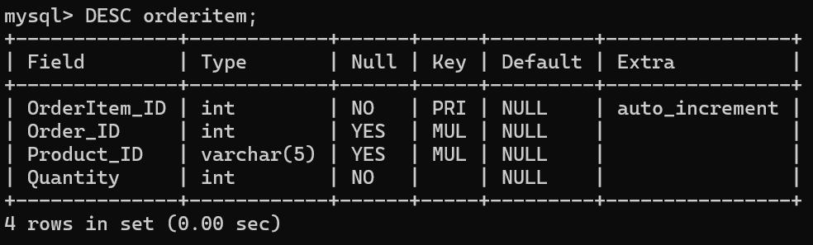
ORDER TABLE:
ORDERITEMS TABLE:

Slide 7
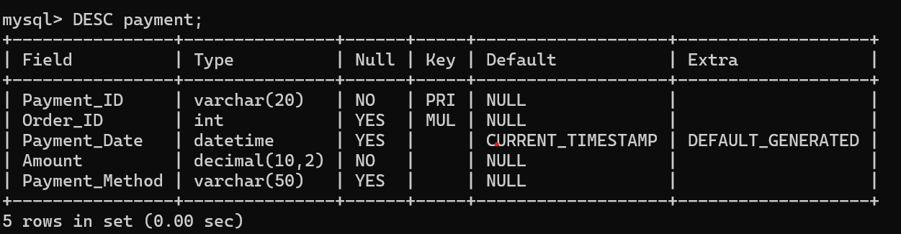
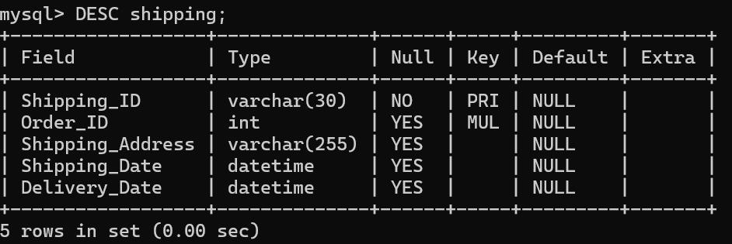
PAYMENT TABLE :
SHIPPING TABLE :

Slide 8
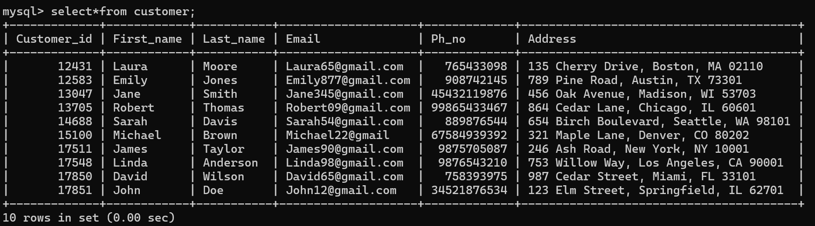
SAMPLE DATA OF TABLES
CUSTOMER:

Slide 9
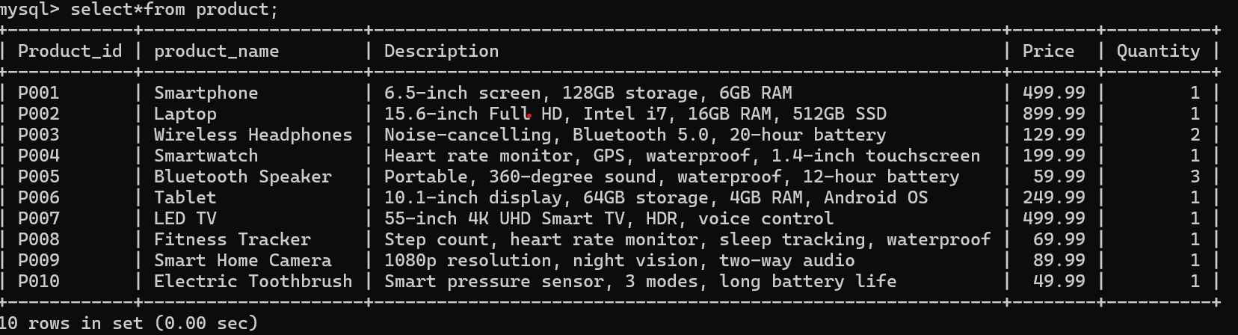
PRODUCT :

Slide 10
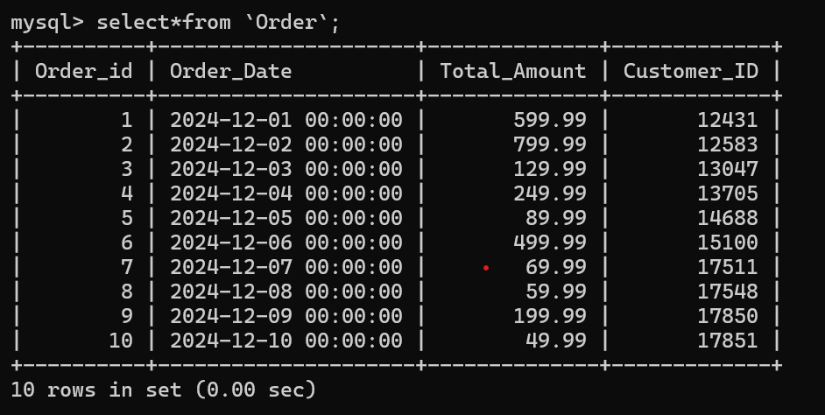
ORDER:

Slide 11
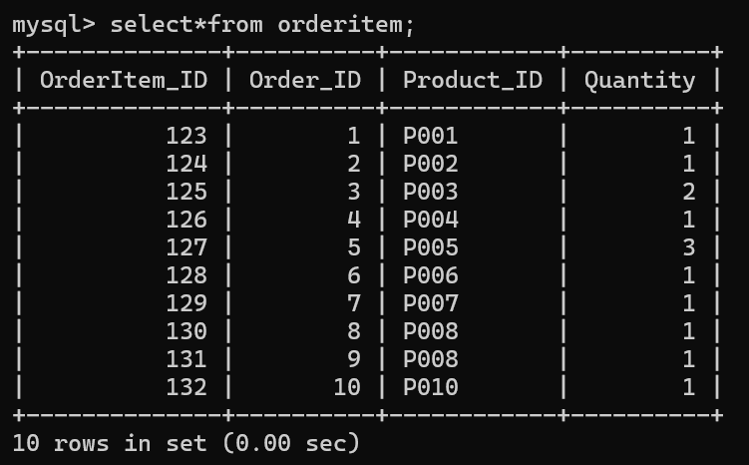
ORDERITEM:

Slide 12
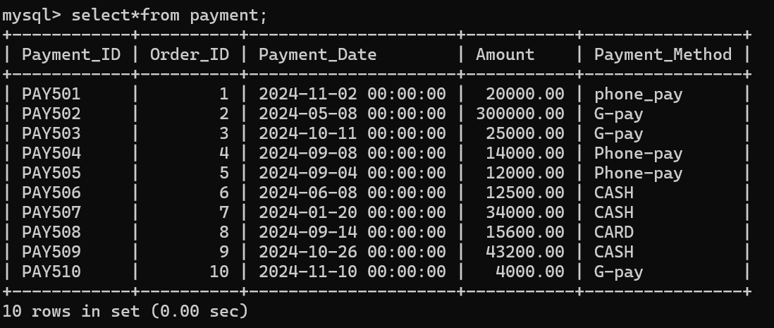
PAYMENT:

Slide 13
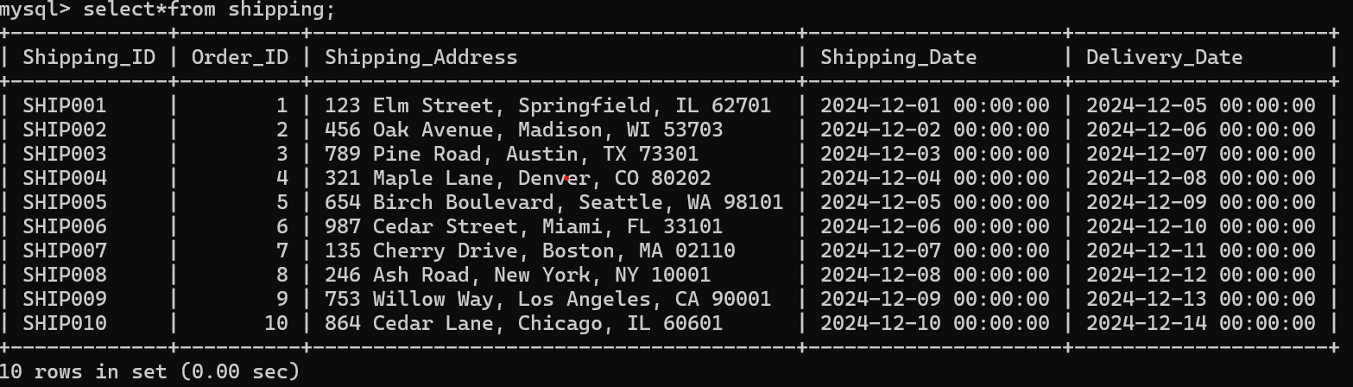
SHIPPING:

Slide 14
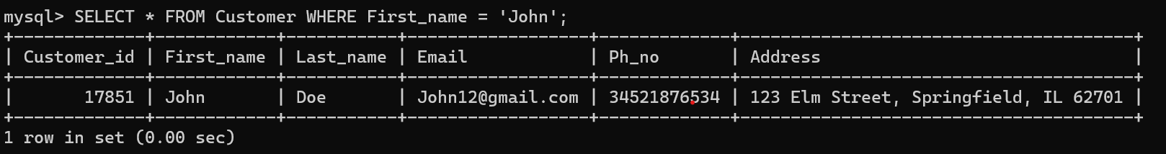
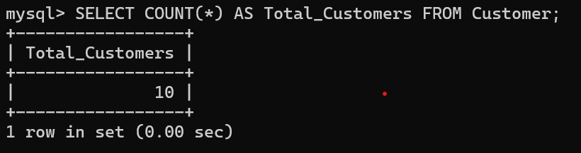
QUERIES
Question 1: Find customer details where the first name is 'John’.
Answer:
SELECT * FROM Customer WHERE First_name = 'John';
Question 2 : Count the total number of customers.
Answer:
SELECT COUNT(*) AS Total_Customers FROM Customer;

Slide 15
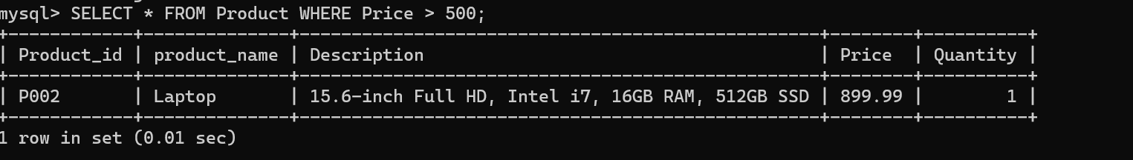
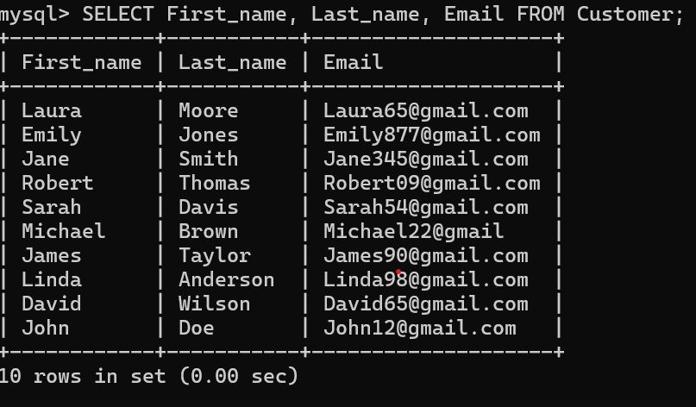
Question 3: Retrieve all products priced above $500
Answer:
SELECT * FROM Product WHERE Price > 500;
Question 4: Get the names and email addresses of all customers
Answer:
SELECT First_name, Last_name, Email FROM Customer;

Slide 16
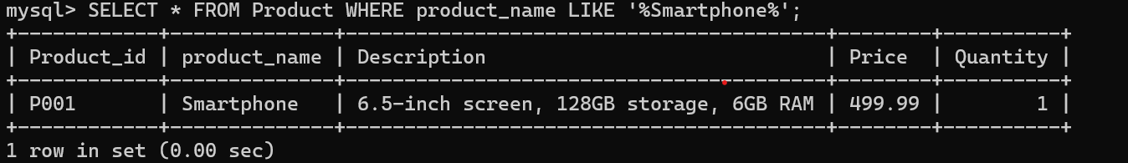
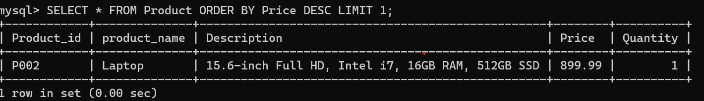
Question 5: Find products that have 'Smartphone' in their description.
Answer:
SELECT * FROM Product WHERE Dproduct_name LIKE '%Smartphone%';
Question 6 : Display the most expensive product.
Answer:
SELECT * FROM Product ORDER BY Price DESC LIMIT 1;

Slide 17
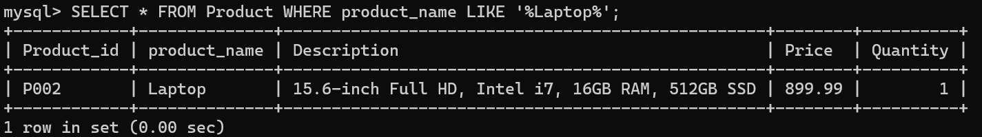
Question 7: Update the email of a customer with Customer_id = 17851
Answer:
UPDATE Customer SET Email = 'newemail@example.com' WHERE Customer_id = 17851;
Question 8 : Show all products where the product name contains 'Laptop'
Answer:
SELECT * FROM Product WHERE product_name LIKE '%Laptop%';

Slide 18
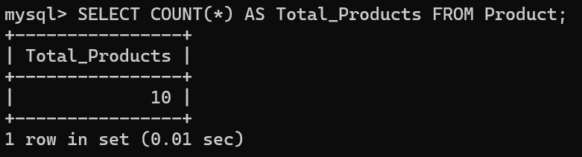
Question 9: Select all customers whose phone number is NULL.
Answer:
SELECT * FROM Customer WHERE Ph_no IS NULL;
Question 10 : Count the number of products available in the Product table.
Answer:
SELECT COUNT(*) AS Total_Products FROM Product;

Slide 19
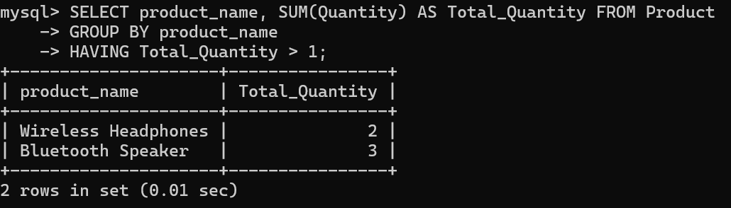
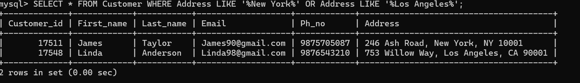
Question 11: Get the total quantity of each product where total quantity is greater than 1
Answer:
SELECT product_name, SUM(Quantity) AS Total_Quantity
FROM Product GROUP BY product_name HAVING Total_Quantity > 1;
Question 12: Use logical operators to filter customers who live in 'New York' or 'Los Angeles'
Answer:
SELECT * FROM Customer WHERE Address LIKE '%New York%' OR Address LIKE '%Los Angeles%';

Slide 20
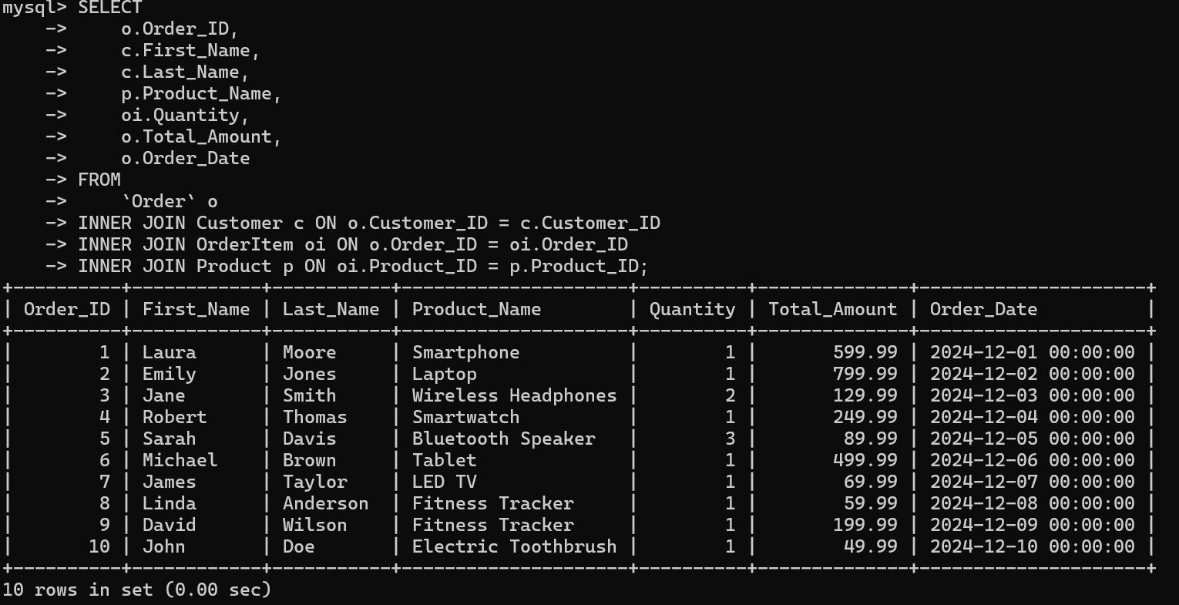
Question 13: Inner Join: Retrieve Order Details with Customer and Product Information
Answer:
SELECT
o.Order_ID,
c.First_Name,
c.Last_Name,
p.Product_Name,
oi.Quantity,
o.Total_Amount,
o.Order_Date
FROM
`Order` o
INNER JOIN Customer c ON o.Customer_ID = c.Customer_ID
INNER JOIN OrderItem oi ON o.Order_ID = oi.Order_ID
INNER JOIN Product p ON oi.Product_ID = p.Product_ID;

Slide 21
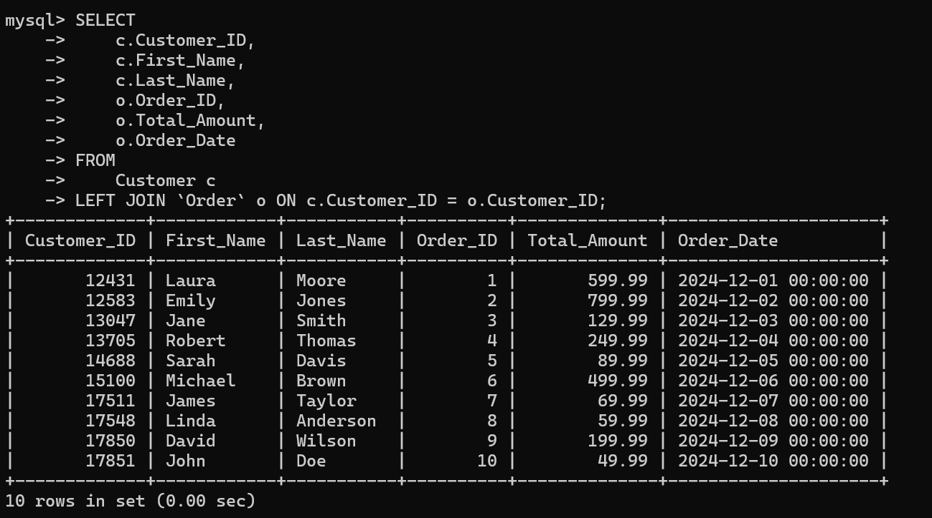
Question 14: Left Join: Show All Customers and Their Orders (Including Customers with No Orders)
Answer:
SELECT
c.Customer_ID,
c.First_Name,
c.Last_Name,
o.Order_ID,
o.Total_Amount,
o.Order_Date
FROM
Customer c
LEFT JOIN `Order` o ON c.Customer_ID = o.Customer_ID;

Slide 22
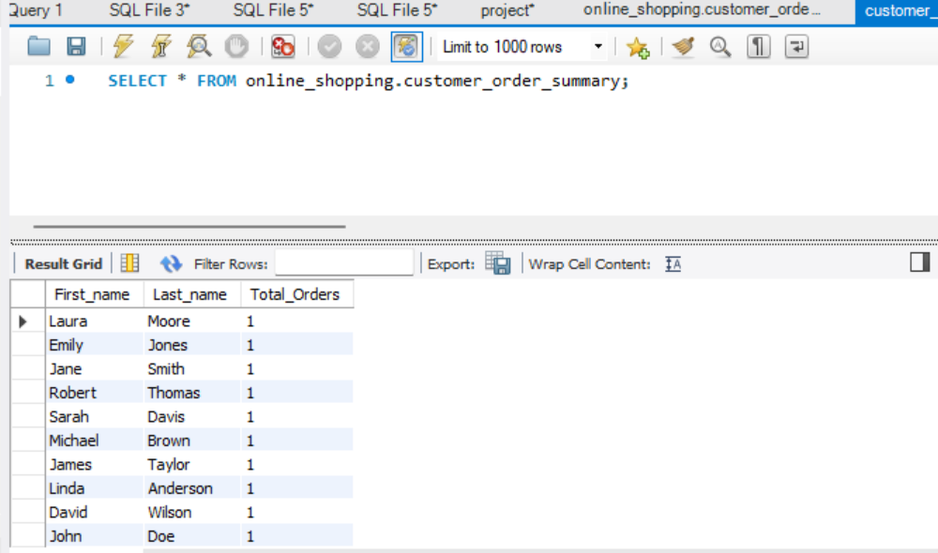
Question 15: Create a view to display customer names and their total orders.
Answer:
CREATE VIEW Customer_Order_Summary AS
SELECT Customer.First_name, Customer.Last_name, COUNT(Orders.Order_id) AS Total_Orders
FROM Customer
LEFT JOIN `Orders` ON Customer.Customer_id = Orders.Customer_id
GROUP BY Customer.Customer_id;

Slide 23


